Slide 1
Egypt University of Informatics · Data Analysis
Egypt's Tourism
Under Fire
Measuring the Impact of Crises on Visitor Arrivals (1995–2019)
Mostafa Elnagar · Yousef Eslam · Ahmed Samy · Adham Shams
Egypt University of Informatics | Data Analysis Course

Slide 2
RESEARCH QUESTIONS
The Problem We Set Out to Solve
"Egypt earns billions from tourism — but one crisis can erase years of growth overnight."
This study examines 25 years of inbound tourism data to understand how political upheaval, security incidents, and economic shocks have shaped Egypt's visitor arrivals — and what the numbers truly reveal.
1
2
Biggest Single-Year Drop
Recovery Duration
Which crisis caused the most severe collapse in visitor arrivals in a single calendar year?
How many years does it take Egypt to return to pre-crisis arrival levels after each major shock?
3
4
Neighborhood Effect
Statistical Significance
Do neighboring countries — Morocco, Tunisia, Jordan — experience the same drops at the same time?
Are the observed drops statistically significant, or could they be explained by normal year-to-year variation?

Slide 3

DATA & METHODOLOGY
How We Built the Analysis
Turbulent Years Flagged
Data Source
Countries & Period
The following years were identified as crisis years based on documented geopolitical and security events:
World Bank indicator ST.INT.ARVL — annual inbound tourist arrivals, a globally standardized and peer-reviewed dataset.
Egypt, Morocco, Tunisia, Jordan — covering 1995 to 2019. That's 25 years × 4 countries = 100 data points.
Turbulent years were selected based on documented events — a limitation discussed in Slide 10.
Data Transformation
Statistical Test
Reshaped from wide to long format using pd.melt(). Year-over-year percentage change computed via pct_change().
Independent two-sample t-test via scipy.stats comparing stable years vs. turbulent years (2011, 2013, 2014, 2016).
2011
2013
2014
2016
Arab Spring Revolution
Political Instability
Security Deterioration
Sinai Plane Crash

Slide 4
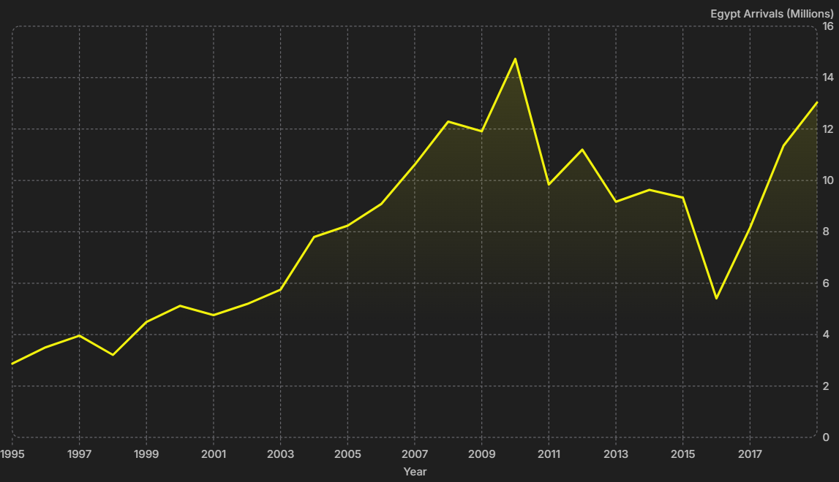
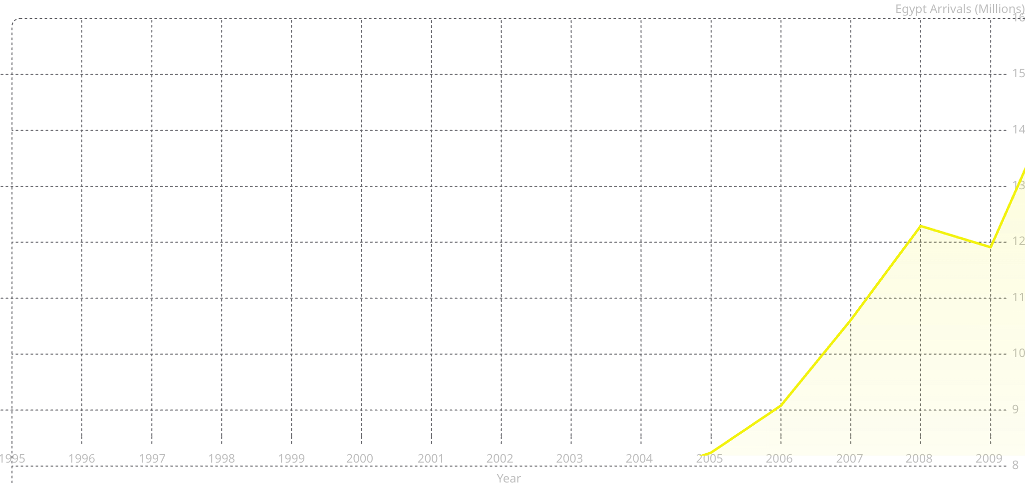
EGYPT'S JOURNEY
From 3M to 14.7M — and Back
Egypt's inbound tourism grew steadily for 15 years before a series of crises reversed decades of progress. The chart below traces the full arc of arrivals from 1995 through 2019, with key crisis moments annotated.
🏆 2010 Peak
⚡ 2011 Arab Spring
14.7M arrivals — Egypt's all-time high before the revolution
Arrivals collapsed to 9.84M — a −33.2% single-year drop
💥 2016 Sinai Crash
📈 2019 Recovery
Deepest trough at 5.41M — the worst year in two decades
Climbed back to ~13M — resilience, but not yet at peak

Slide 5

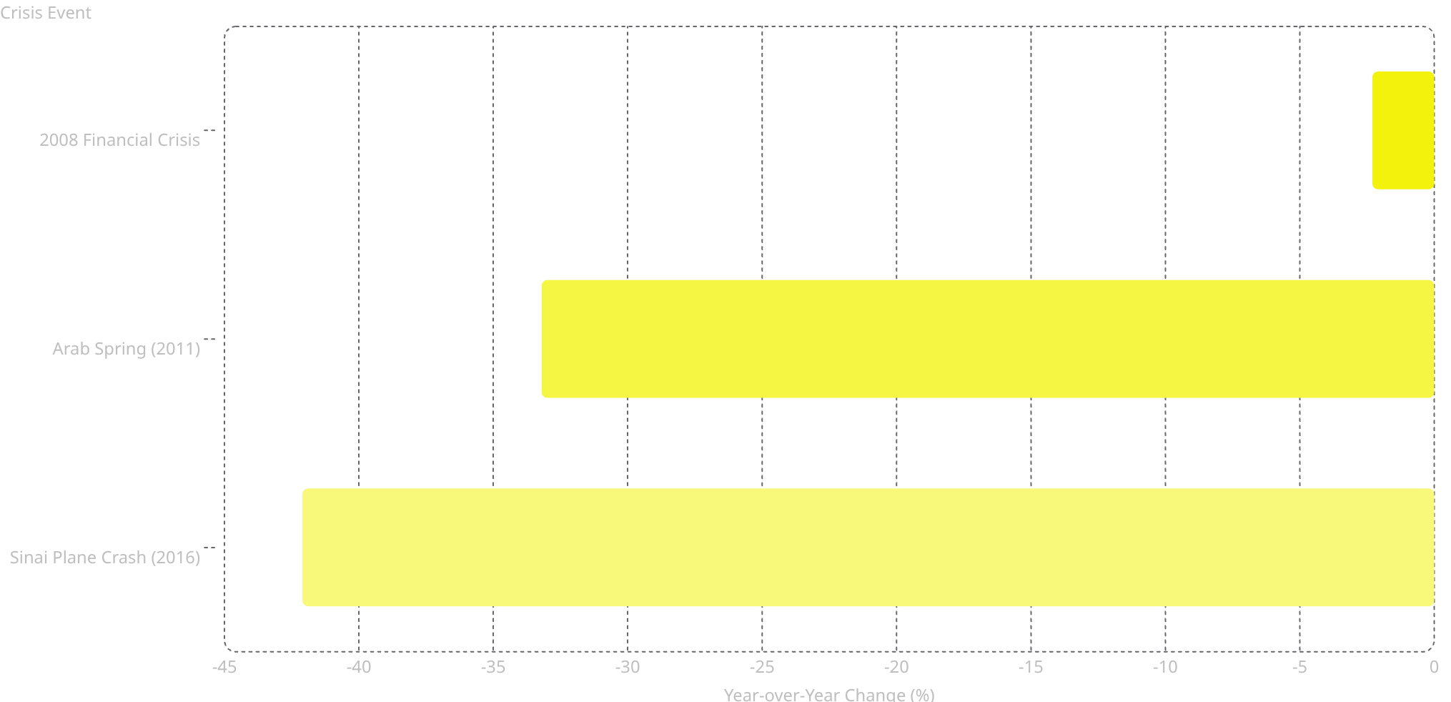

CRISIS COMPARISON
The Sinai Crash Hurt More Than the Revolution
The Counterintuitive Finding
Most people assume the Arab Spring — a full-scale political revolution — would be Egypt's worst tourism disaster. The data tells a different story.
-2.3
-33.2
Security incidents trigger deeper fear responses than political events — tourists avoid perceived physical danger more than political instability.
-42.1
−42.1%
−33.2%
−2.3%
Sinai Plane Crash 2016 — the single largest drop ever recorded
Arab Spring 2011 — devastating, but second place
2008 Financial Crisis — barely a blip by comparison

Slide 6
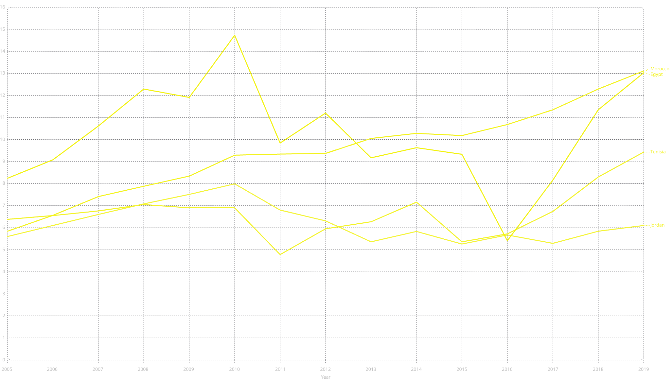
REGIONAL ANALYSIS
Not Everyone Falls Together
Comparing Egypt against its North African and Middle Eastern neighbors reveals a striking divergence: crisis impact is country-specific, not a regional phenomenon. Morocco's trajectory in 2011 is the clearest proof.
🇪🇬 Egypt
🇲🇦 Morocco
Two catastrophic drops in 2011 and 2016 — the most volatile trajectory of all four countries studied.
Kept growing through 2011 — political stability and geographic distance from the Arab Spring epicenter shielded it completely.
🇹🇳 Tunisia
🇯🇴 Jordan
Collapsed in 2011 alongside Egypt — as a direct Arab Spring country, it suffered similarly severe drops.
Moderate decline in 2011 — partially affected by regional instability but recovered faster than Egypt or Tunisia.

Slide 7

STATISTICAL TESTING
Hypothesis Testing: Are the Crashes Real?
The Hypotheses
H₀ — Null Hypothesis
H₁ — Alternative Hypothesis
There is no real difference in average year-over-year growth rate between stable years and turbulent years. Any observed drops are random variation.
There IS a statistically significant difference in average YoY growth between stable and turbulent years. The crashes are real shocks.
The Test
We applied an independent two-sample t-test using scipy.stats.ttest_ind(), comparing the distribution of YoY % changes in stable years versus flagged turbulent years (2011, 2013, 2014, 2016).
Test Results
3.76
0.0011
T-Statistic
P-Value
Strong separation between the two groups
Far below the 0.05 threshold
p < 0.05 → We reject H₀. The drops are NOT random noise — they are statistically proven, mathematically significant shocks to Egypt's tourism system.
Plain English: If these drops were just normal variation, we'd expect to see a result like this less than 0.11% of the time by chance alone. The crises are real.

Slide 8
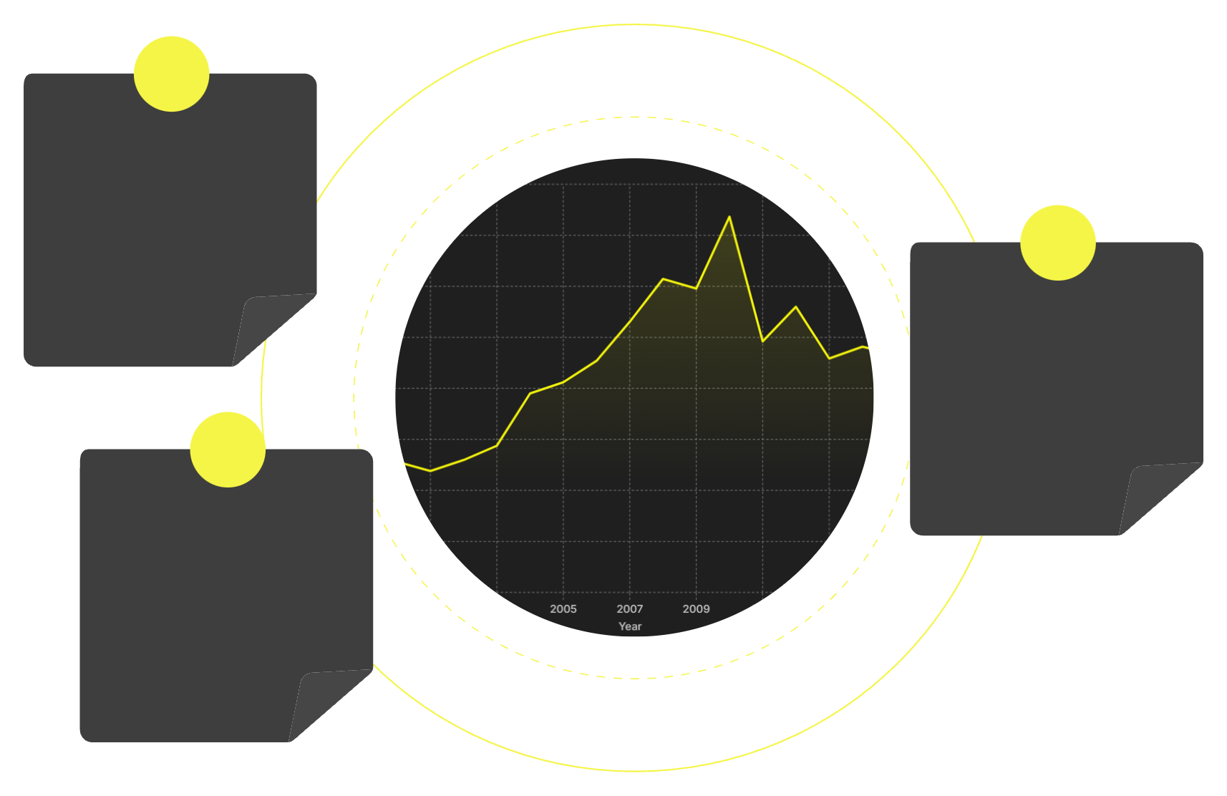
RECOVERY ANALYSIS
Egypt Always Bounces Back — But It Takes Years
Recovery speed is not uniform. The nature of the crisis — economic vs. security-driven — fundamentally determines how long it takes for tourist confidence to return.
2008 Financial Crisis
2008 Crisis
Recovered within 1 year. A −2.3% dip followed immediately by a record-breaking 2010. Economic shocks are temporary — tourists return when their wallets recover.
Minor blip — recovered within 1 year
Arab Spring 2011
Security shock — ~4+ years to recover
Arab Spring (2011)
Required 4+ years to approach pre-crisis levels. Political instability creates prolonged uncertainty, but the destination's appeal eventually wins back visitors.
Sinai Crash 2016
Deep damage — still recovering by 2019
Sinai Crash (2016)
Still recovering by 2019 — 3+ years and counting. Aviation bans from Russia and the UK compounded the damage, making this the slowest recovery on record.
The pattern is clear: security events cause deeper, longer damage than economic ones. Tourists can rationalize economic downturns, but perceived physical danger triggers lasting behavioral change.

Slide 9


KEY FINDINGS
What the Data Tells Us
After analyzing 25 years of inbound tourism data across four countries, four major findings emerge — some expected, some deeply counterintuitive.
Finding 1: Sinai > Arab Spring
Finding 2: Crisis Is Country-Specific
The Sinai Plane Crash (−42.1%) caused a larger single-year drop than the Arab Spring Revolution (−33.2%). Security fear outweighs political instability in tourist decision-making.
Morocco grew in 2011 while Egypt and Tunisia collapsed. Regional proximity does not equal shared vulnerability — governance, stability, and perception matter more than geography.
Finding 3: Mathematically Proven
Finding 4: Resilience Takes Time
p = 0.0011 — the crisis drops are not random noise. The t-test confirms with 99.89% confidence that turbulent years are statistically distinct from stable years.
Egypt always recovers — but major security shocks require 3–5 years per event. Economic crises heal in under a year. The type of crisis determines the length of the wound.
These findings have direct policy implications: Egypt's tourism ministry should prioritize security perception management and aviation partnerships as the fastest levers for recovery acceleration.

Slide 10
LIMITATIONS & FUTURE WORK
What We Couldn't Do — and What Comes Next
⚠️ Current Limitations
🔭 Future Research Directions
01
Annual Data Granularity
We used annual figures only. Monthly data would allow us to pinpoint the exact timing of each shock and measure how quickly the market reacted in real time.
Extend to 2020–2024
Include the COVID-19 era to quantify the pandemic's impact and compare it against historical crises — likely the most dramatic drop ever recorded.
Manual Year Selection
02
Turbulent years (2011, 2013, 2014, 2016) were chosen based on known events — introducing potential selection bias. Automated outlier detection would be more rigorous.
Automated Outlier Detection
Replace manual year flagging with algorithmic methods (e.g., Z-score thresholds, IQR-based detection) to eliminate selection bias entirely.
2019 Data Cutoff
03
The dataset ends before COVID-19 — almost certainly the largest tourism collapse in modern history. Our findings exclude what may be the most important case study of all.
Add Revenue Data
Arrivals tell only half the story. Incorporating tourism revenue data would reveal whether Egypt attracted fewer but higher-spending visitors during recovery phases.
"Egypt's tourism is resilient — but preparation matters."Understanding the past 25 years of shocks is the first step toward building a tourism sector that can withstand the next one.
Mostafa Elnagar 24-101443 · Yousef Eslam 24-101303 · Ahmed Samy 24-101314 · Adham Shams 24-101192Egypt University of Informatics | Data Analysis

